Slide 1
Making Major Financial Decisions
Unit 7
Unit 7: Getting Started
Topic 1: Paying for a Vehicle Should you get a used or new vehicle? What’s the difference between leasing and buying a vehicle?
Topic 2: Renting or Buying a Home When it comes to housing, is it better to rent or buy? What should you know before deciding?
Topic 3: Understanding Insurance Why do people pay for insurance and how does it work?
Topic 4: Choosing an Insurance Plan How do you select an insurance plan? What can you do to reduce your insurance costs?
Topic 5: Understanding Your Consumer Rights What information do you need to make wise financial decisions?
Wrap Up Glossary of Key Terms Personal Action Plan Continuing the Conversation at Home Dig Deeper

Slide 2
Unit 7: Getting Started
This unit explores a wide variety of personal finance topics within the theme of Making Major Financial Decisions. Going into this unit, how much do you already know about each topic?
 | Not Much | Some | A Lot
Topic 1: Paying for a Vehicle Should you get a used or new vehicle? What’s the difference between leasing and buying a vehicle? Learn about paying for a vehicle, including the factors that impact costs, benefits and tradeoffs of new and used cars, and what to expect for ongoing costs.
Topic 2: Renting or Buying a Home When it comes to housing, is it better to rent or buy? What should you know before deciding? Explore options for housing—both renting and buying—and learn about home loans.
Topic 3: Understanding Insurance Why do people pay for insurance and how does it work? Discover how insurance works, why people choose to use insurance, and what factors influence the price of insurance.
Topic 4: Choosing an Insurance Plan How do you select an insurance plan? What can you do to reduce your insurance costs? Consider questions to ask when choosing an insurance policy and explore ways to lower future insurance costs.
Topic 5: Understanding Your Consumer Rights What information do you need to make wise financial decisions? Learn about consumer rights and how to avoid becoming the victim of a scam or financial fraud.

Slide 3
Paying for a Vehicle
After completing the module for this topic, you should be able to:
List factors to consider when buying a vehicle.
Explain the benefits and tradeoffs of buying a new versus used vehicle.
Compare buying and leasing a vehicle.
Summarize the financial considerations of getting a vehicle.

Slide 4
Use in conjunction with the Paying for a Vehicle self-paced module.
What do you anticipate when it comes to paying for a vehicle? Is this something you’ve already done, plan to do in the next few years, will consider in the future, or doubt you will encounter? Explain.
Think about the type of vehicle you would prefer. Provide a description of one that fits each category.
 | Dream Vehicle What you’d get if price were not a factor | More Practical Factoring in cost, the vehicle you think is more realistic | Bare Bones The least expensive vehicle you’d be comfortable driving
Type Sedan, Sports Car, SUV, Truck, etc.
Make
Model
Trim Level Luxury, Mid-level, Basic
New or Used If used, what year?
Preferred Color

Slide 5
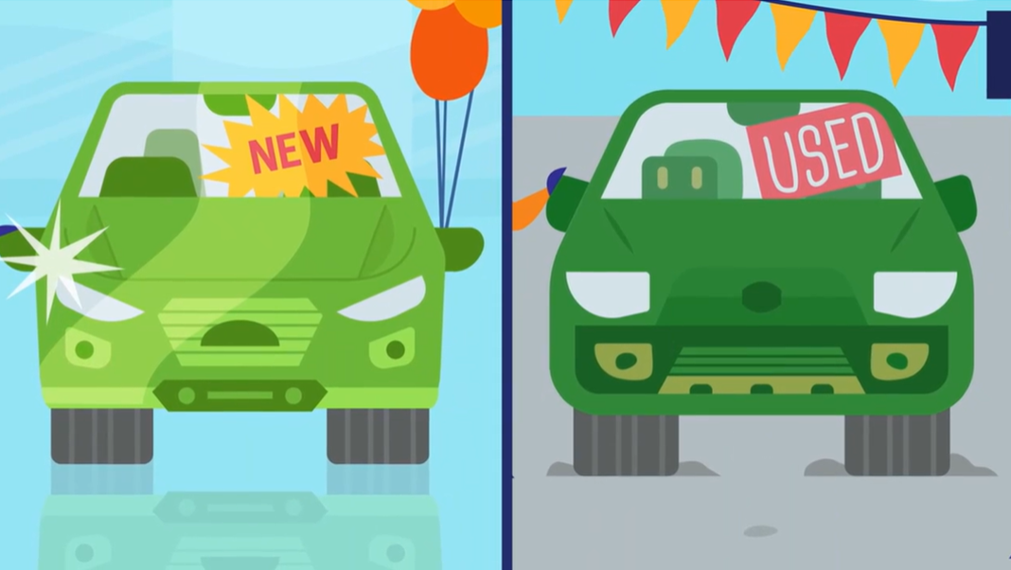
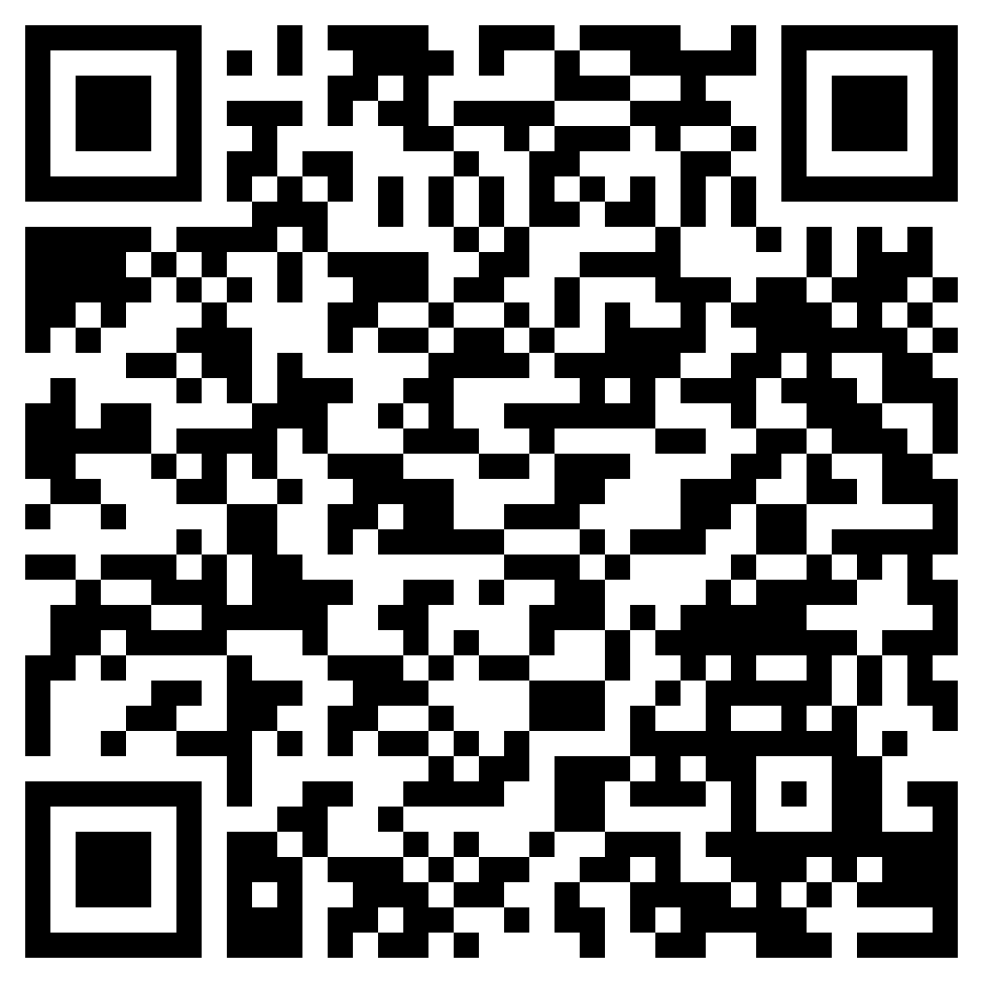

New Versus Used
Use in conjunction with the animated video found in the Paying for a Vehicle self-paced module.
Use this link or the QR code to the right to watch the video from this module and answer the questions below. You’ll end up watching it three times—looking for something different each time.
Watch the video. Identify key ideas and details from the video and write them below.
Watch the video a second time. Identify and define three key vocabulary terms.
Term | Definition
Watch the video a third and final time. How does the video connect to what you already knew about new and used vehicles?

Slide 6
Use in conjunction with the Paying for a Vehicle self-paced module.
There are pros and cons to both new and used cars. Fill in the chart below with the information you learned in the video and other thoughts you have about each.
 | New | Used
Pros
Cons
Which would you choose and why?
Remember this if you decide to buy!
The more money you can pay for the down payment, the ________ you will have to pay each month for a loan or lease payment.
Mark each piece of advice as true or false. | T/F
Some car dealers allow you to negotiate for how much you pay, while others insist that you pay the “sticker” price. Find out which kind you are dealing with.
Be sure you know the total price of the vehicle, including taxes and any fees for things like the title and tags.

Slide 7
Use in conjunction with the Paying for a Vehicle self-paced module.
Do a quick search. Find three websites or apps that allow you to compare prices of vehicles at different dealers and list one feature you like about each.
Name
Is it a website, app, or both? If a website, include the URL.
One or more features you like
Which of the following do you think you might use to pay for a vehicle someday? Put an X next to all that apply.
Money you have saved (either for the full amount or towards a down payment) |  | Get a car loan from a bank or credit union and make regular payments
Borrow money from a family member |  | Have an adult cosign a loan with you
What are some of the benefits and tradeoffs of leasing a vehicle? What does leasing have in common with buying?
Benefits of Leasing | Tradeoffs of Leasing | Commonalities with Buying

Slide 8
Use in conjunction with the Paying for a Vehicle self-paced module.
Consider the ongoing costs of having a vehicle. Which best describes the choice you’d likely make? Place an X in the box. Then explain the impact your answer is likely to have on your transportation budget.
Question | X | Answers | Impact on Your Transportation Budget
How many miles do you plan to drive each week? |  | I anticipate driving many miles each week.
 |  | I’d say my gas needs will be about average.
 |  | I don’t expect to need to refill my tank very often.
Will your vehicle use more or less gas than others? |  | I expect my vehicle will be newer, smaller, or compact with very good gas mileage.
 |  | The vehicle I end up with will probably have “average” gas mileage.
 |  | I plan to have an electric or hybrid vehicle.
 |  | My choice of vehicle will likely require more gas.
What are your plans for vehicle maintenance? |  | I will probably take my car someplace for routine maintenance.
 |  | I can change my own oil and filter.
 |  | I can probably learn to do it myself with a little help.
How much can you expect to pay in repairs? |  | I plan to have a new car with a good warranty.
 |  | My car will likely be older and might require more maintenance.
 |  | I hope to only have a few, low-cost repairs.
What kind of insurance do you plan to have? |  | I want the best possible coverage and don’t mind paying a bit extra to get it.
 |  | I plan to have an “average” plan—more than is required but not the very best coverage, either.
 |  | I only want to have what is required in my state.

Slide 9

Use this page to reflect on what you have learned in Topic 1: Paying for a Vehicle.
In your own words, what should someone consider before deciding to get a vehicle? Be sure to mention new and used vehicles, buying vs. leasing, and the total cost of having a car.
End-of-Module Self-Evaluation
Consider the learning objectives for this module. How do you feel about each one after completing it? | Strongly Agree | Somewhat Agree | Somewhat Disagree | Strongly Disagree
I can list factors to consider when buying a vehicle.
I am able to explain the benefits and tradeoffs of buying a new versus used vehicle.
I can compare buying and leasing a vehicle.
I am confident summarizing the financial considerations of getting a vehicle.

Slide 10
Renting or Buying a Home
After completing the module for this topic, you should be able to:
Discuss differences between renting and buying a home.
Explain the benefits and tradeoffs of buying versus renting a home.
Describe how changes in the housing market can impact home equity.
Share how credit can impact both renters and home buyers.

Slide 11






Use in conjunction with the Renting or Buying a Home self-paced module.
Consider each of the following events. How far into the future do you expect each to take place, if ever?
Future Event | 0 to 5 Years | 6 to 10 Years | Longer or Never
Live on my own or without family (can still be with a roommate)
Take full responsibility for my own housing costs
Sign a lease on my own for an apartment or home
Buy a home of my own
Take notes on each of the following key terms. Include a definition and/or example of each.
Tenants
Landlord
Lease
Security Deposit
Rent Payment
Utilities

Slide 12
Use in conjunction with the Renting or Buying a Home self-paced module.
The decision to rent involves weighing the potential benefits and tradeoffs. List examples of each.
Benefits | Tradeoffs
There are many vocabulary terms involved with buying a home. Fill in the graphic organizer with definitions or examples of each.
Purchase Price | Mortgage
Down Payment | Collateral
Home Buying Terms

Slide 13

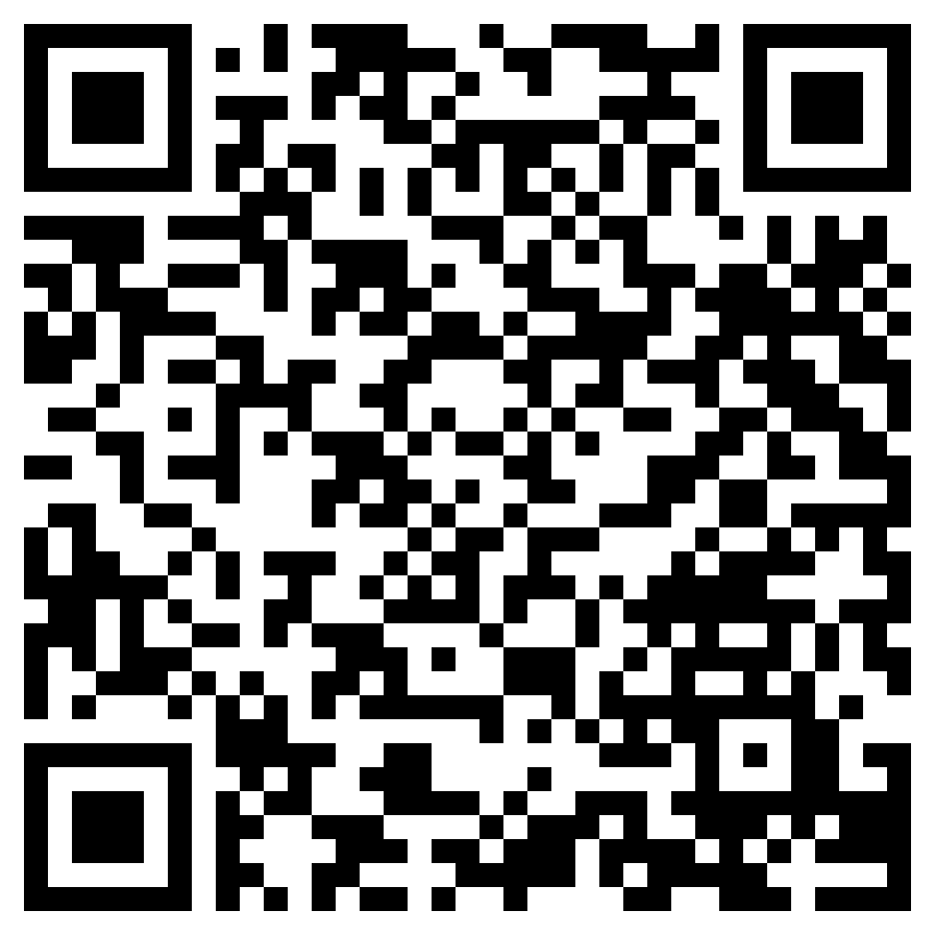
Investing in Home Ownership
Use in conjunction with the animated video found in the Renting or Buying a Home self-paced module.
Use this link or the QR code to the right to replay the video from this module.
Think about what you knew about the topic of home ownership and mortgages going into the module and what you learned from the video. Write a paragraph (3–5 sentences) about what you knew and how watching the video expanded on your prior knowledge.

Slide 14

Use in conjunction with the Renting or Buying a Home self-paced module.
Decisions about homeownership are likely many years into the future for you, but it doesn’t hurt to start thinking about which way you might lean. Which aspects of each choice appeal to you? Try and think of at least two for each: buying and renting.
Renting | Buying
Credit plays a role in both buying and renting. Explain the impact credit can have for each in your own words.
Renting
Buying

Slide 15
Use this page to reflect on what you have learned in Topic 2: Renting or Buying a Home.
The module’s wrap up concludes with, “Both options involve thinking about what you want and need and doing your homework.” Explain this statement in the context of this module.
End-of-Module Self-Evaluation
Consider the learning goals for this module. How do you feel about each goal after completing this topic? | Strongly Agree | Somewhat Agree | Somewhat Disagree | Strongly Disagree
I can discuss differences between renting and buying a home.
I am able to explain the benefits and tradeoffs of renting versus buying a home.
I can describe how changes in the housing market can impact home equity.
I understand how credit can impact both renters and home buyers.

Slide 16
Understanding Insurance
After completing the module for this topic, you should be able to:
compare strategies to handle risk, including avoiding, accepting, reducing, and transferring it.
explain why people choose to purchase insurance.
examine how you might handle situations involving risk.
describe various types of insurance and how each is used.

Slide 17
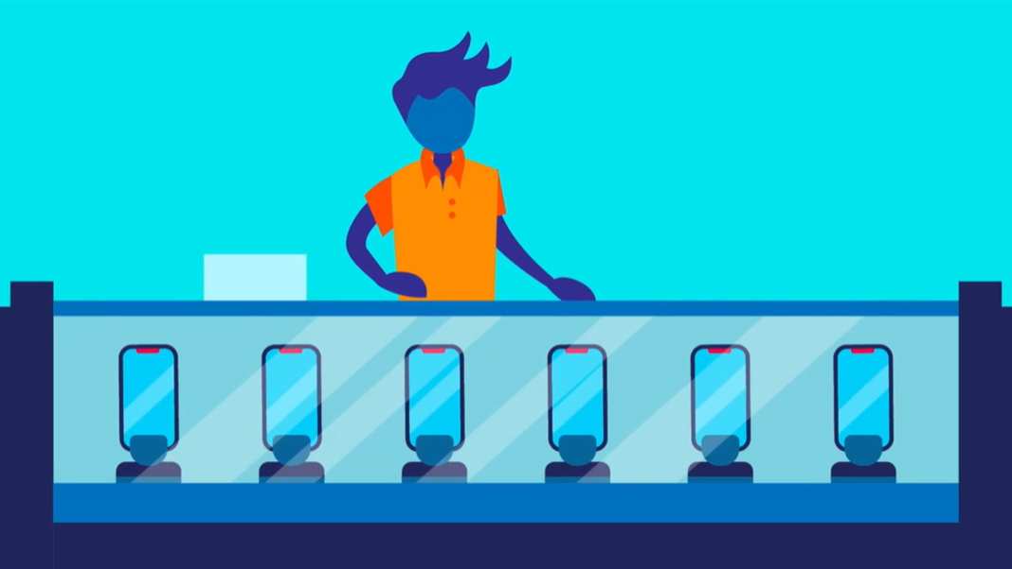
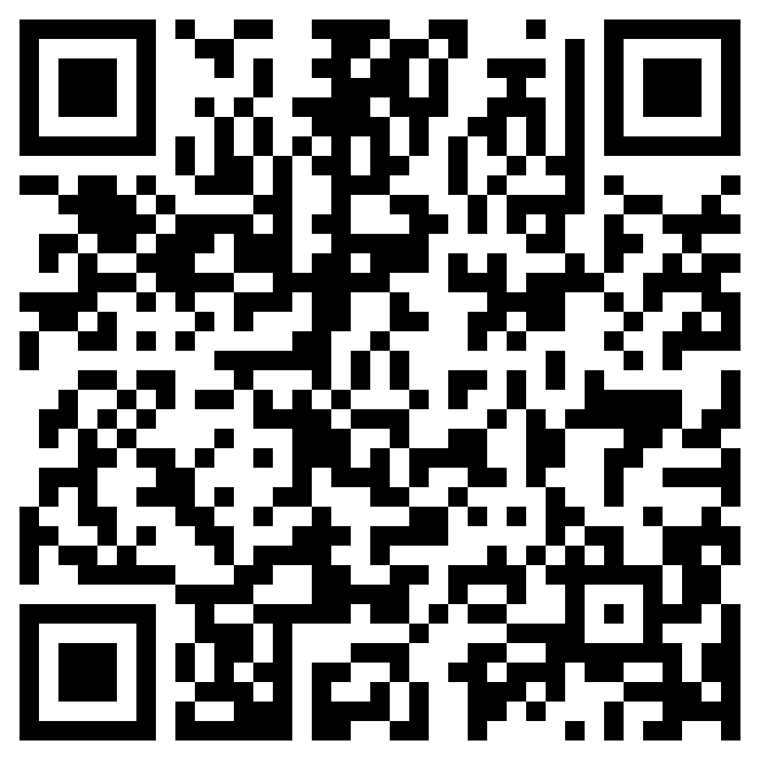
Risk and Insurance
Use in conjunction with the animated video found in the Understanding Insurance self-paced module.
Use this link or the QR code to the right to watch the video from this module. Respond to the questions below.
What did you SEE in the video that was interesting?
What do you KNOW now that you didn’t before watching the video?
What do you WONDER as a result of watching the video?

Slide 18




Use in conjunction with the Understanding Insurance self-paced module.
The video shared four strategies for addressing risk. Think of three scenarios that involve risk and list them below. Then, come up with a way to apply each strategy to the scenarios you listed.
# | Scenario
1
2
3
Avoid the Risk
Scenario | Way to Apply the Strategy
1
2
3
Accept the Risk
Scenario | Way to Apply the Strategy
1
2
3
Reduce the Risk
Scenario | Way to Apply the Strategy
1
2
3
Transfer the Risk
Scenario | Way to Apply the Strategy
1
2
3

Slide 19
Use in conjunction with the Understanding Insurance self-paced module.
There are many types of insurance. Fill in the table with information about these four kinds.
 | What Does it Cover? | When Might You Use It?
Auto
Disability
Health Including Medicare and Medicaid
Homeowners and Renters
Life
Unemployment
Take notes on the insurance-related terms. Include a definition and/or example of each.
Term | Your Notes
Claim
Deductible
Liability
Premium

Slide 20
Use in conjunction with the Understanding Insurance self-paced module.
Describe four factors that might influence how much you pay for insurance.
1
2
3
4
What word(s) fills in each blank in the paragraph below?
Insurance is a way to ______1_____ risk from you to the insurance company. You pay a ____2_____ every so often, but the insurance company pays if there is a big loss—minus any ____3_____ you might owe. There are many types of insurance. Some of the most common are health, auto, renters and homeowners, disability, and life insurance. You may be able to influence the cost of insurance by ____4_____ risks and selecting ____5_____ levels. You will have many decisions to make about insurance in the future. Make sure you understand your options and the risks you face if you don’t have insurance.
1
2
3
4
5

Slide 21
Use this page to reflect on what you have learned in Topic 3: Understanding Insurance.
Summarize what you learned in this module. Be sure to describe the relationship between risk and insurance, several examples of insurance, and what impacts insurance costs.
End-of-Module Self-Evaluation
Consider the learning objectives for this module. How do you feel about each objective after completing it? | Strongly Agree | Somewhat Agree | Somewhat Disagree | Strongly Disagree
I am confident in comparing strategies to handle risk, including avoiding, accepting, reducing, and transferring it.
I can explain why people choose to purchase insurance.
I am able to examine how you might handle situations involving risk.
I know how to describe various types of insurance and how each is used.

Slide 22
Choosing an Insurance Plan
After completing the module for this topic, you should be able to:
Explain what factors influence the cost of insurance.
Develop a plan for purchasing insurance in the future.
Describe ways you can reduce your future insurance costs.

Slide 23

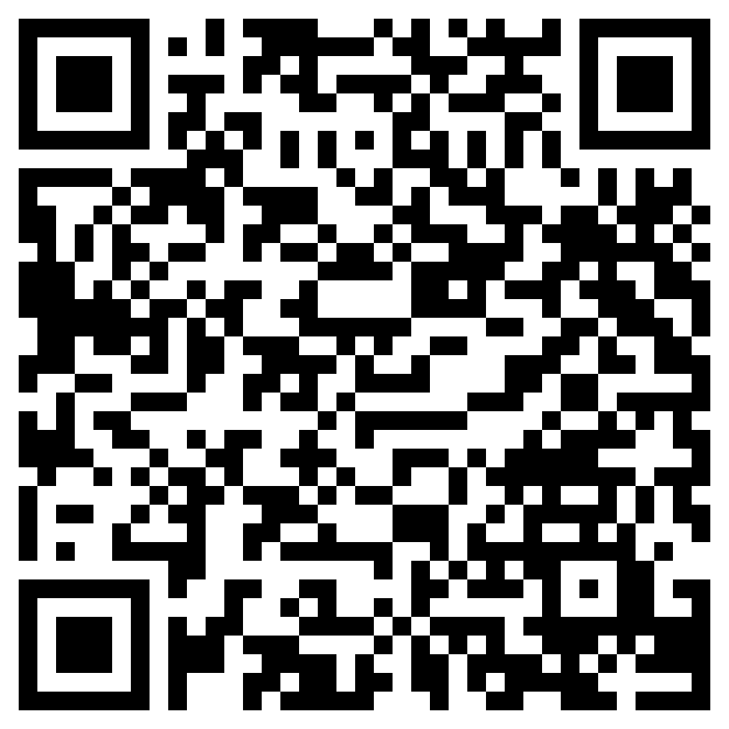
Choosing an Insurance Plan
Use in conjunction with the animated video found in the Choosing an Insurance Plan self-paced module.
Use this link or the QR code to the right to replay the video from this module then consider the “would you rather” question below.
Would You Rather?
Pay for insurance and never end up using it | OR | Save money by not purchasing insurance and run the risk of not having it if something goes wrong
Share your choice and explain your decision.

Slide 24
Use in conjunction with the Choosing an Insurance Plan self-paced module.
Fill in the insurance term that matches each definition. Then, answer why each term is important to know.
Definition | Term | Importance
Request for insurance company to pay
Your share of the cost for a covered health care service, usually calculated as a percentage
Covers your vehicle for anything that is your fault
Maximum amount you can claim
Written contract for insurance
How much YOU pay
Things or circumstances that aren’t covered by your insurance
The amount you might have to pay for a medical expense (short for copayment)
Covers your vehicle for damage that is someone else’s fault
Insurance for family members of the policyholder, such as a spouse, children, or a partner
A feature of a policy that allows you to buy a new version of whatever was lost or damaged
Covers damage you do to other people or their property
The hospitals and doctors contracted to provide services for an agreed-upon rate with your insurance provider
A type of coverage that will pay as much as an item is worth now

Slide 25

Use in conjunction with the Choosing an Insurance Plan self-paced module.
Shopping around for insurance, making sure you get the best policy for you, and understanding everything that is covered takes some time. Use information from the module to create a checklist of questions you might ask when the time comes for you to tackle this.
✔ | Questions I Want to Remember to Ask

Slide 26
Use in conjunction with the Choosing an Insurance Plan self-paced module.
With a little bit of work, you might be able to lower some of your future insurance costs. Fill in the graphic organizer with ideas for each category.
Shop Around | Deductible
Auto Insurance Discounts | Personal Decisions (Health & Home)
Ways to Lower Insurance Costs
What factors are you likely to consider when selecting an insurance policy? List the top four and explain why each is important.
Factor | Your Reason

Slide 27
Use this page to reflect on what you have learned in Topic 4: Choosing an Insurance Plan.
What do you know about insurance that you didn’t know or understand before the module? Explain.
End-of-Module Self-Evaluation
Consider the learning goals for this module. How do you feel about each goal after completing it? | Strongly Agree | Somewhat Agree | Somewhat Disagree | Strongly Disagree
I am able to explain what factors influence the cost of insurance.
I feel confident in my ability to develop a plan for purchasing insurance in the future.
I can describe ways to reduce my future insurance costs.

Slide 28
Understanding Your Consumer Rights
After completing the module for this topic, you should be able to:
Explain why scams are important to avoid.
Give examples of laws and institutions designed to help consumers.
Describe how a consumer can get help if they suspect a scam or financial fraud.

Slide 29

Use in conjunction with the Understanding Your Consumer Rights self-paced module.
How would you describe yourself as a consumer? After taking the “Consumer Quiz,” what areas might you work on to improve your consumer skills?
When it comes to consumer rights and responsibilities, what do you already know? How about scams? What do you want to know? Complete the first two columns now. Come back when the module is done, and share what you learned.
Know What do you already know about this topic? | Want What do you want to know about this topic? | Learn What have you learned after completing the module?

Slide 30

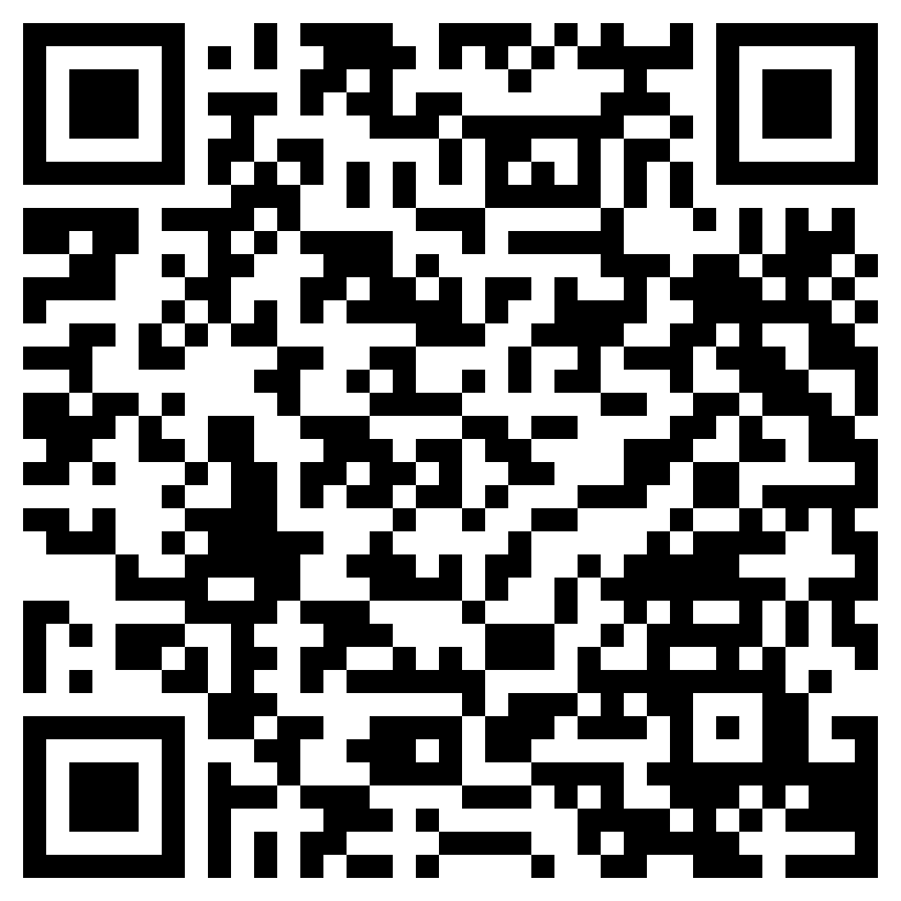
Use in conjunction with the animated video found in the Understanding Your Consumer Rights self-paced module.
Consumer Rights and Responsibilities
Your first thought when you see the letters AEIOU might be about vowels versus consonants, but in this case it is an abbreviation for a Adjective, Emotion, Interesting, Oh, and Um.
Use this link or the QR code below to replay the video from this module. As you watch it, think of answers to the questions corresponding to each vowel in the abbreviation.
A—Adjective What words describe what you saw?
E—Emotion How does it make you feel?
I—Interesting Info What do you find interesting?
O—Oh! Did something surprise you?
U—Um? What questions do you have?

Slide 31

Use in conjunction with the Understanding Your Consumer Rights self-paced module.
What steps can you take to prevent becoming a victim of scams or financial fraud? List at least two for each category.
Websites
Emails
Phone Calls
Imposters
Sales People
Social Media

Slide 32
Use in conjunction with the Understanding Your Consumer Rights self-paced module.
Select one of the scams from the Don’t Get Scammed section. Who do you know that might fall victim to this scam? Draft a message to them explaining what to look out for and how to avoid it.
Consider each strategy you could use to prevent falling for a scam. When or how might you use it?
Strategy | Potential Use
Search online for a phrase that describes your situation, like “IRS call” or a questionable phone number.
Slow down, check out the offer, consult an expert, or just tell a friend or trusted adult.
Say, “put me on your do not call list” and then hang up.
Take Steps to Prevent Unwanted Contact
You can register your phone number with the National Do Not Call Registry at donotcall.gov. Once you begin to have a credit history, you are likely to receive what are called “prescreened offers” of credit. These are offers you haven’t asked for, and if scammers get ahold of them they could open accounts in your name. The Federal Trade Commission suggests opting out of these via optoutprescreen.com or calling 1-888-5-OPT-OUT.

Slide 33

Use in conjunction with the Understanding Your Consumer Rights self-paced module.
Create your own reference sheet of organizations that help consumers where you live. Fill in the table with the name, website, and phone number for each agency listed below. Include how they help consumers.
 | Name and Contact Information | How They Help Consumers
Federal Trade Commission (FTC) | Federal Trade Commission (FTC)
Your State’s Attorney General naag.org/find-my-ag
Your State’s Banking Regulator csbs.org/state-bank-directory
Your State’s Insurance Regulator content.naic.org/state-insurance-departments
Local Law Enforcement

Slide 34
Use this page to reflect on what you have learned in Topic 5: Understanding Your Consumer Rights.
At the beginning and end of this module, you were asked to consider the statement, “I know what to look for and how to protect myself from common scams.” How would you answer someone if you were asked about this? What questions do you still have about the topic?
Reminder: Go back to the first page for this module and complete the “Learn” column of the chart.
End-of-Module Self-Evaluation
Consider the learning goals for this module. How do you feel about each goal after completing it? | Strongly Agree | Somewhat Agree | Somewhat Disagree | Strongly Disagree
I am able to explain why scams are important to avoid.
I feel confident giving examples of laws and institutions designed to help consumers.
I can describe how a consumer can get help if they suspect a scam or financial fraud.

Slide 35
Making Major Financial Decisions
Wrap Up

Slide 36
Unit 7: Glossary of Key Terms
Term | Definition | My Notes
Auto Insurance | Insurance which protects vehicle owners and/or drivers when damage is done to themselves, their vehicle, someone else, or someone else’s property
Claim | A request for payment of a loss covered by an insurance policy
Collateral | Something of value pledged by a borrower to be given to the lender should the borrower fail to repay a loan
Collision Insurance | Insurance that pays for repairing or replacing your car if it's damaged in a collision with another vehicle or object
Comprehensive Insurance | Insurance that covers damage to your vehicle from incidents other than collisions, such as theft, vandalism, or natural disasters
Consumer Protection | The laws and other forms of government regulation designed to protect consumers from harm or loss
Contract | A legally binding agreement that outlines the rights, obligations, and terms of a specific transaction or relationship
Copay | The amount you pay for medical services or prescriptions at the time of service, with the remaining cost covered by insurance

Slide 37
Unit 7: Glossary of Key Terms (continued)
Term | Definition | My Notes
Credit | The ability to buy something now and pay for it later
Deductible | The amount of money an insured person pays before the insurance company makes payments for loss
Dependent | Someone who relies on another person for financial support, often a family member, and meets certain insurance or tax criteria
Depreciation | The reduction in the value of an asset over time, due in particular to wear and tear
Down Payment | A portion of the purchase price paid in cash when the rest is paid with borrowed money
Equity | A property’s current market value minus any money that is owed on the property
Exclusions | Specific situations or conditions listed in an insurance policy for which coverage will not be provided
Federal Trade Commission | A federal government agency tasked with protecting consumers, often called the FTC

Slide 38
Unit 7: Glossary of Key Terms (continued)
Term | Definition | My Notes
Foreclosure | The process through which a lender takes possession of a mortgaged property as a result of the borrower’s failure to make mortgage payments
Health Insurance | Insurance that pays for a person’s medical and/or surgical expenses, as needed
Homeowners Insurance | Insurance that protects a homeowner from loss in the case of fire, theft, natural disasters, etc.
Insurance | A means of protection from financial loss in which, in exchange for a fee, a party agrees to compensate another party in the event of a certain loss, damage, or injury
Landlord | A person who rents land, a building, or an apartment to a tenant
Law | A rule or order that it is advisable or obligatory to observe
Lease | A contract by which one party conveys land, property, services, etc. to another for a specified time, usually in return for a periodic payment
Liability Insurance | Insurance coverage for injuries or damages the insured person causes to others

Slide 39
Unit 7: Glossary of Key Terms (continued)
Term | Definition | My Notes
Life Insurance | Insurance that pays a person’s loved one(s) a predetermined amount of money when the person dies
Mortgage | A loan for the purchase of a home or real estate
Network | In the context of health insurance, network refers to healthcare providers (doctors, hospitals, clinics) that have a contracted agreement with your insurance company to provide services at negotiated rates
Phishing | A scam by which an internet user is tricked into revealing personal or confidential information, usually through an email message
Policy | The written document detailing an arrangement for insurance
Premium | The amount of money an individual or business pays for an insurance policy
Regulation | A rule or order issued by an executive authority or regulatory agency of a government and having the force of law
Rent | Paying someone for the use of something, or the money paid in exchange for the use of something

Slide 40
Unit 7: Glossary of Key Terms (continued)
Term | Definition | My Notes
Renters Insurance | Insurance that protects a renter from loss in the case of fire, theft, natural disasters, etc.
Risk | The possibility of loss
Security Deposit | Money paid by a tenant to a landlord which is returned to the tenant at the end of the lease unless used to pay for any damage or unpaid rent
Skimmer | A device placed over of a credit or debit card reader and used by scammers to collect card information
Tenant | A person who occupies land or property rented from a landlord
Utilities | Electricity, gas, water, sewer, and other services that may or may not be included in a tenant’s rent
Warranty | A written guarantee, issued to the purchaser of an article by its manufacturer, promising to repair or replace it if necessary within a specified period of time

Slide 41
Unit 7: Personal Action Plan
Consider each of the topics addressed in this unit. Which actions will you take to prepare yourself for making major purchases? | Already Doing | Need to Do | Not in My Plans
I will compare prices and options before buying or leasing a vehicle.
I will consider the benefits and tradeoffs of any big decision before making it.
I will work to establish and maintain good credit to help me save money when borrowing.
I will get in the habit of reading the terms and conditions of agreements before I sign them.
I will compare prices, features, and benefits before selecting an insurance policy.
I will put my phone number on the Do Not Call registry.
I will be cautious and ask for assistance to prevent falling victim to a scam.
My notes and next steps:

Slide 42
Unit 7: Continuing the Conversation at Home
Families often approach conversations about money very differently. Some might welcome them, while others avoid the topic as much as possible. Review the conversations starters below. With whom could you have each conversation? How might you approach the conversations?
Conversation Starters | My Notes
Shopping for a Vehicle What was the first vehicle you purchased? What were you hoping to get at the time? Did you end up with what you planned to purchase? Thinking back on vehicles you might have purchased, what do you wish you’d known when you were my age? What factors do you think are most important to consider when shopping for a car?
Renting or Buying a Home What are your thoughts on renting versus buying? What do you see as the pros and cons of each? Have you ever rented a place to live? What was that experience like? Looking back, do you wish you’d made any different decisions about where to live and how to pay for it?
Insurance What insurance products does our family currently use? Have you ever shopped around for insurance policies, either to compare prices or get better coverage? What aspects of insurance do you feel well-informed about? Are there others that you aren’t as clear on or you wish you knew more about? When do you think I’ll need to make my own decisions about insurance and for what type(s) of coverage?
Consumer Protection Do you know anyone who has ever been a victim of a scam or some form of fraud? What happened? How did they find out? Are there things you think our family could do better to protect ourselves from being scammed?

Slide 43
Unit 7: Dig Deeper
Interested in learning more about the topics covered in this unit? Consider exploring one or more of the following questions.
Dig into the Topics | My Notes
Shopping for a Vehicle What are some of the best-rated tools (websites, apps, etc.) for comparing prices on new and/or used vehicles? Which car dealers in the area negotiate price and which ones have firm pricing strategies (i.e., everyone pays the sticker price)?
Renting or Buying a Home What are the prices of homes in your area? Have home prices in your area increased or decreased in recent years? What is the typical cost to rent an apartment where you hope to live someday?
Insurance Which insurance products and companies does your family use? Do you have insurance cards? Do you know where they are or where to access them? What should you do if you are hurt or in an accident as far as insurance goes? What factors influence your family’s insurance costs? Is there anything you can do to help bring that down?
Consumer Protection What are the most common scams in your state? Do any of them specifically target teens? Who should you contact if you discover that you are the victim of a scam?

